Slide 1


Cloud Computing Overview
Richard Herlihy
D19125630

Slide 2

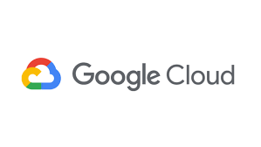


What is the cloud?
Computer services delivered over internet
Decentralised / remote hosting
Service-oriented consumption (like utilities)
Both a disruptive innovation and an "IS outsourcing" option
CPU/GPU, RAM, storage, applications
Usually situated @ highly-efficient data centres run by Microsoft, Amazon, Google, etc.
Use cases
Hosting: Websites, virtual learning environments (Moodle/Blackboard)
Compute: Big data analytics, machine learning
Storage & backup: Images, videos, unstructured data, databases
Applications: Test & build apps; provide on-demand software (web apps, thin clients)

Slide 3




Why does TU Dublin
need cloud services?
Broadly: to host some or all IT services
. Specifically: to host a Virtual Learning Environment (VLE)
Potential cost-savings
Cloud providers have large economy of scale, utility pricing
Currently: many TU Dublin services hosted “on-premises”
Costly maintenance: CapEx frontloaded (multi-year investment). Most hardware capacity not fully utilised.
With cloud, switch to operational expense (OpEx)
Annual, monthly (or even hourly) fees
Only pay for what you need
Some services go hand-in-hand with cloud:
IoT, streaming, video retrieval, services
CCTV
In-classroom lecture recording / on-demand streaming
Linking university services via web APIs (HR, student recruitment, finance, assessment)

Slide 4




Cloud features
#1 On-demand, self-service
Pay as you go model & measured service/billing
Automatic/unilateral provisioning of extra virtualised resources
#2 Resource pooling
Physical resources pooled dynamically and subdivided; user not concerned w/ actual machines/location. Greatly reduced overhead.
Near-infinite scalability (e.g. for future expansion)
#3 Rapid elasticity
Quickly acquire + release resources as needed
Near-unlimited resources to meet peak demand (or to reduce during off-peak)
#4 Resiliency, redundancy, distribution
Highly fault-tolerant / highly available
Access anywhere on any device. Data centres/regions provide reliability regardless of geographic location
Partly adapted from NIST definition of cloud computing; measured service merged into self-service for brevity.

Slide 5





Deployment models
Private cloud
TU Dublin buys + maintains physical hardware*
Utilises virtualisation and distributed computing/storage
University retains maximum security/privacy oversight
Lower CapEx than on-prem
Improved resource pooling
Services better-distributed across campuses
Potentially more overhead/maintenance
On-prem (non-cloud)
TU Dublin buys + maintains physical hardware
Hardware dedicated to specific services
Maximum security/privacy
Significant CapEx (up-front costs)
Difficult to anticipate future demand/capacity
Limited resource pooling
Public cloud
Services reside on industry cloud provider (AWS, MS, etc.)
Multi-tenancy model. (Customers share physical hardware via sandboxed virtual environments)
Flexibility to accommodate IaaS, PaaS, or SaaS as needed
Maximum availability, elasticity and resource pooling. Extensibility of load balancers, compute, storage, etc.
Minimised overhead/maintenance: Zero CapEx
Security & privacy a major concern
Public cloud
Other models
Community
TU Dublin shares private cloud with 1 or more organisations (e.g. other Irish universities)
Hybrid
Integrated mixture of on-prem, private, public, or community cloud
*Physical infrastructure for private cloud deployment can also be provided by a local 3rd-party host/partner.

Slide 6


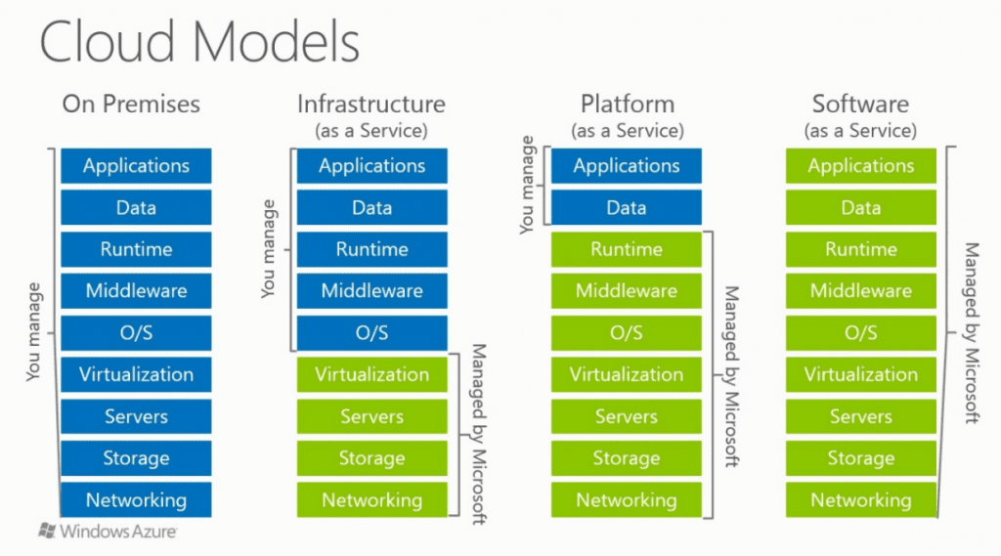

Service types
Infrastructure-as-a-Service (IaaS)
Raw computing resources. (Closest to on-prem)
Resources pooled via virtual machines (VMs). 1 server = many VMs.
Additional resources (storage, networking) configurable + attached
Users have direct access: install OS’s (Linux/Mac), DBs, apps, etc.
Benefits: lowest cost; more control
Examples: remote desktops for students (labs), host machines for legacy university services (academic records, finance, etc.)
Platform-as-a-Service (PaaS)
Ready-to-use environment to install/develop apps
OS, database, middleware, etc. usually provided
Benefits: less setup needed; easier to deploy apps
Examples: web server (Apache, Node/Express) to host TU Dublin website; deploy a custom VLE like Moodle; app framework/environments (RoR, Django) for student projects
Software-as-a-Service (SaaS)
Ready-to-use cloud software
Benefits: no installation (access + admin via browser); works on any device; reduces complex IT management
Examples: Google Drive, Microsoft Outlook, Brightspace (VLE-as-a-Service)
Source: Super Admins / Microsoft

Slide 7
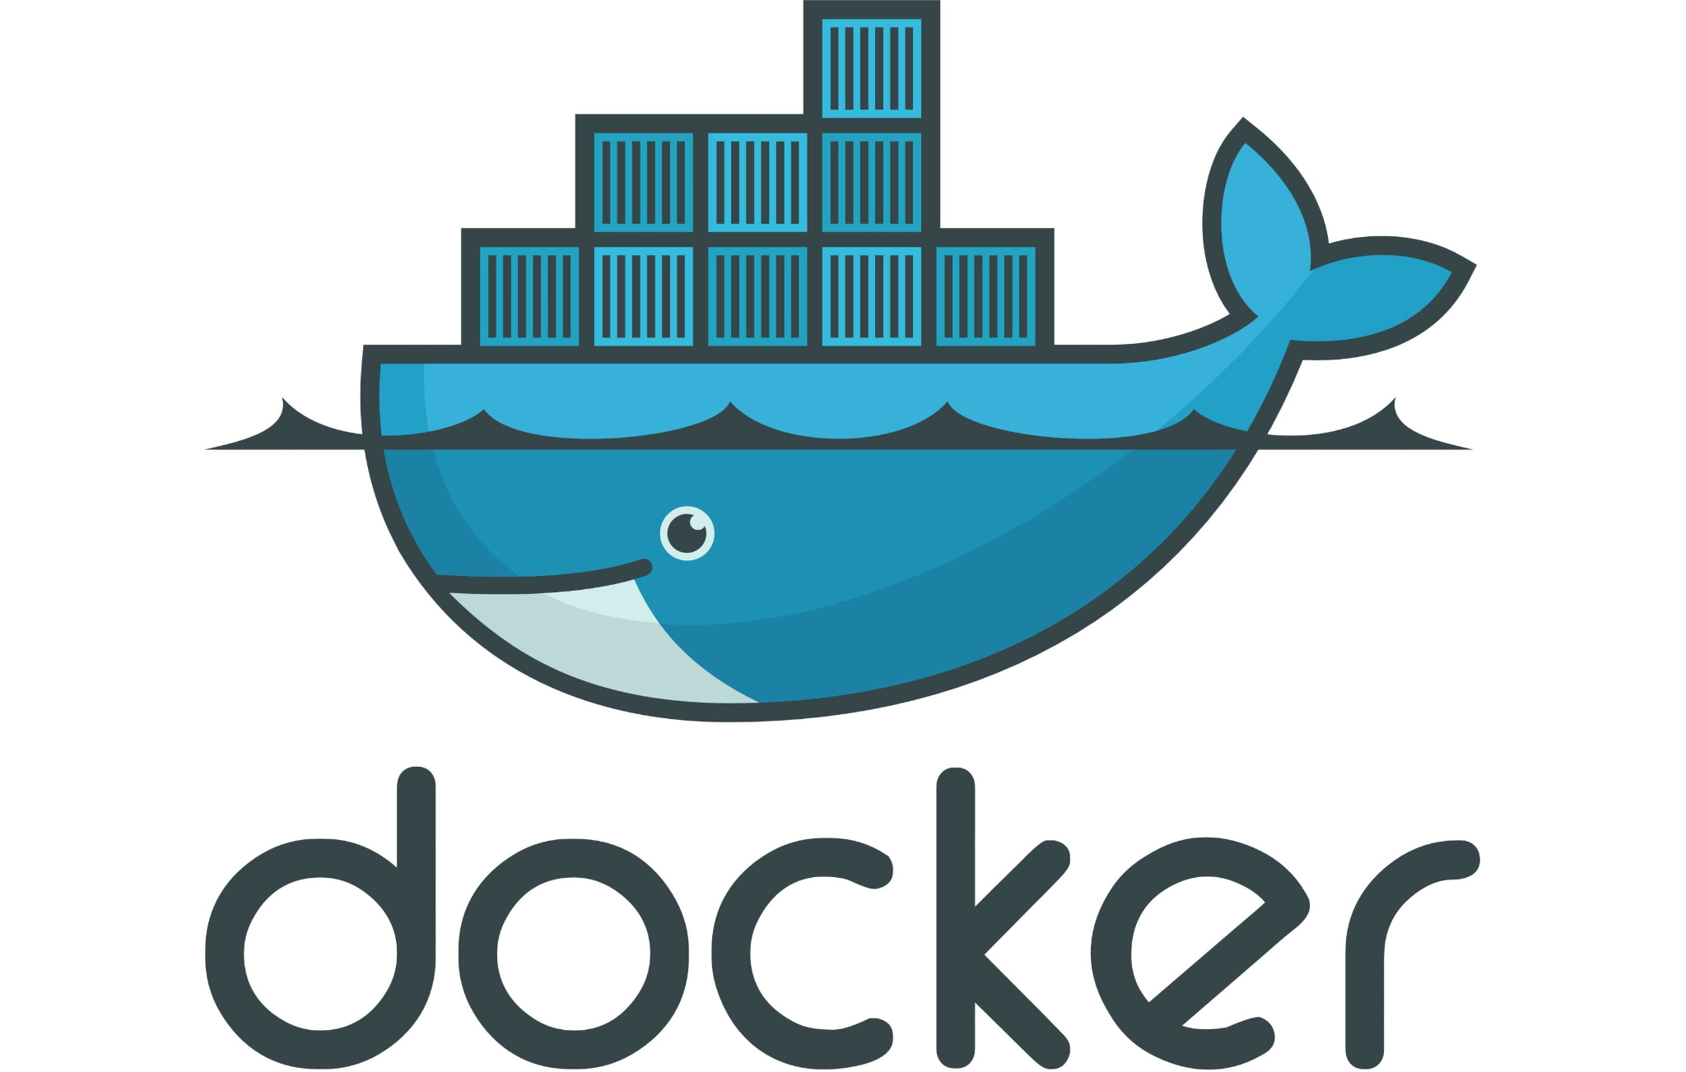

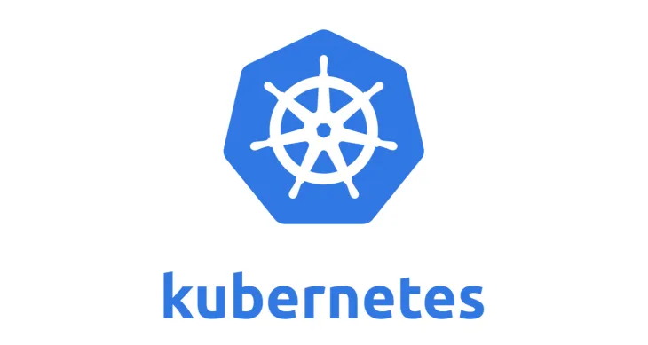
Virtualisation &
containers
Containers
Docker
Slimline, efficient type of virtualisation
Shares kernel with physical machine or underlying layer while maintaining isolation
Greatly reduced overhead (memory, etc.)
Easy to create "images" of software and its environment; simplifies version control & updates
Virtualisation
Virtual machine (VM): an emulation of physical computer on top of another machine
Hypervisor - native execution allowing multiple isolated environments on top of an OS (e.g. Windows, Linux)
IaaS gives direct control/installation of full VMs; PaaS and SaaS also run on VMs but this is abstracted away from users
Use cases:
Cloning images for distributed computing (i.e. in cloud)
Testing multiple operating systems
Special software development environments
Remote desktops (student labs)
Kubernetes
Container-orchestration system
Automates app deployment, scaling and management

Slide 8
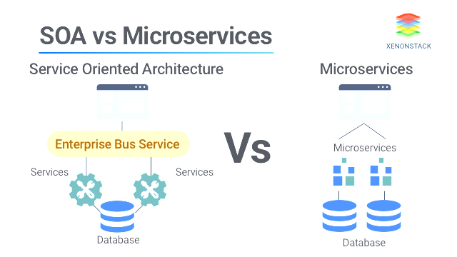

Service-oriented architectural model (SOA)
Applicable to TU Dublin cloud services
Using RESTful architecture
Source: XenonStack
Properties of “services” in SOA
Logically represents a business activity with specified outcome. (E.g. Student records API)
Self-contained
Black box for consumers (inner workings not exposed)
May consist of underlying services
What are the benefits of SOA?
Allows university systems to be better integrated, easier to modify/upgrade, and cheaper to maintain. On-prem SOA architecture can be integrated with cloud services via a Hybrid Model.
Microservices: an alternative model more closely aligned to cloud computing and distributed services

Slide 9

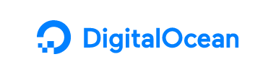
Vendor comparison
VENDOR
SERVICE MODELS | IaaS + PaaS + SaaS | IaaS + PaaS | IaaS + PaaS + SaaS | PaaS, SaaS | IaaS + PaaS
USP, DETAILS | Largest industry cloud provider. (Revenue greater than AWS + Google combined). SaaS includes Office 365, Outlook | Lowest* costs. But potentially higher operations staffing required (maintenance & configuration) | Innovator; newest technology Superior SaaS (Google Docs, Gmail) | Business-oriented (ERP, CRM, etc.) and fewer options. Industry-leader in some services (HR, Finance, etc.). | Lowest costs (*even lower than AWS on some services) PaaS offering is very recent; not as mature as AWS/Azure.
 | Wide range of IaaS/PaaS services Existing TU Dublin usage/integrations | Widest range of IaaS/PaaS services. Largest number of LMS-hosting partners. | Specialises in big data, AI, APIs (Google Maps). But many PaaS services not necessarily relevant to TU Dublin. | But some services (PaaS, e.g. Heroku) at higher cost | Support for some VLEs
LOCATION | Nearest data centre is ~7km from Grangegorman | Grangegorman is ~7km from EU-WEST-1; AWS’s oldest EU data centre | Nearest data centre: 11km from Grangegorman. Claims it is sustainability industry leader (i.e. energy efficiency). | No Irish data centre. Nearest data centre is non-EU (London) | No Irish data centre. Nearest data centre is non-EU (London)

Slide 10


Cloud summary and takeaways
Strengths
Economical: reduce costs, share resources
Improve billing/pricing: expenses re-assessed year-on-year
Rapid & changeable deployment. Minimal off-peak OpEx (e.g. summer).
Environmental benefits. (Reduced grey emissions from hardware).
Relatively risk-free, “trial-and-error approach”
Higher performance: near-unlimited capacity to meet peak/excess demand
Reduce complexity of detail of SysOps
Full-service infrastructure or software.
Reduced staffing overhead for PaaS/SaaS models: IT staff need less time to manage complex operations (i.e. physical hardware/VMs)
Focus on dev + config of services/applications directly
Best student experience: continuous availability (limited downtime), reduced latency/better geographic availability off-campus; rendering for certain web apps & services done on server rather than client (benefits students on weak clients).
Obstacles
Data centres may soon consume 29% of Ireland’s electricity output
Cloud has efficiency gains, but some load may be more energy-efficient on thick clients / on-prem (because of network transmission overhead).
Delegation of security/privacy to cloud provider (lack of transparency; potential for out-of-jurisdiction processing of sensitive data, e.g. student details).
Increased legal oversight needed: data protection assessments; scrutiny of service provider policies.
Vendor lock-in. (Yearly billing changes; extra management/config to ensure IT systems not tightly coupled to provider).
Internet connection needed (even on-campus systems may entail external requests)

Slide 11
References
Amazon Web Services. (2020). AWS Well-Architected Framework. https://docs.aws.amazon.com/wellarchitected/latest/framework/welcome.html
Cloud Wars. (2021). Cloud Wars Top 10—Most Influential Cloud Vendors in the World. https://cloudwars.co/cloud-wars-top-10-vendors-world/
IBM Cloud Education. (2021). SOA (Service-Oriented Architecture). https://www.ibm.com/cloud/learn/soa
Mell, P., & Grance, T. (2011). The NIST Definition of Cloud Computing (NIST Special Publication (SP) 800-145). National Institute of Standards and Technology. https://doi.org/10.6028/NIST.SP.800-145
Rountree, D., & Castrillo, I. (2014). Chapter 4—Cloud Service Models. In D. Rountree & I. Castrillo (Eds.), The Basics of Cloud Computing (pp. 49–94). Syngress. https://doi.org/10.1016/B978-0-12-405932-0.00004-9
Wikipedia. (2021). Service-oriented architecture. In Wikipedia. Retrieved from https://en.wikipedia.org/w/index.php?title=Service-oriented_architecture&oldid=1015876101

